Slide 1



HARDWARE ARCHITECTURES FOR DEEP LEARNING MODELS
Presenters:
1. Towhidul Islam – 202381732 (FPGA)
2. Moni Kishore Dhar – 202380330 (ASIC)
3. Sachi Datta – 202387871 (GPU)
4. Rifat Bin Masud – 202387267 (SiLaGO)
© ENGI-9819(Computer Hardware Found), 2023
www.mun.ca
Notes:
Hello,
Our topics is HARDWARE ARCHITECTURES FOR DEEP LEARNING MODELS
"Imagine a world where machines not only learn but also evolve. Today, we step into the heart of this digital evolution as we explore the dynamic landscape of hardware architectures for deep learning models. Join Us on this journey where silicon meets intelligence, and together, we uncover the foundations of the AI revolution."
We will present 4 different types of Architectures
Me Towhidul Islam will present FPGA
Moni Kishore Dhar will present ASIC
Sachi Datta will present GPU
And Rifat Bin Masud will present SiLaGo

Slide 2

HARDWARE ARCHITECTURES FOR DEEP LEARNING MODELS
Contents
Deep Learning
Field Programmable Gate Array (FPAG)
Application-Specific Integrated Circuit (ASIC)
Graphics processing unit (GPU)
Silicon Large Grain Objects (SiLaGO)
Q&A
© ENGI-9819(Computer Hardware Found), 2023
www.mun.ca
Notes:
In this presentation this are our contents:
First we will explore Deep learning, a cornerstone of artificial intelligence, powers applications from image recognition to natural language processing.
Then we will explore versatile technologies such as Field Programmable Gate Arrays (FPGAs) known for adaptability, custom-designed Application-Specific Integrated Circuits (ASICs) offering high performance, and Graphics Processing Units (GPUs) known for parallel processing. Additionally, we'll uncover the innovative Silicon Large Grain Objects (SiLaGO).

Slide 3
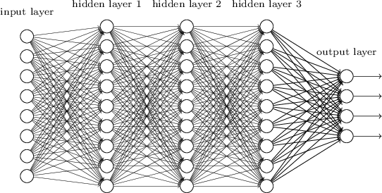
Deep Learning
A neural network is composed of multiple layers of nodes that receive input from other layers and produce an output until a final result is reached.
Example of DNN:
1. Convulational Neural Network
2. Artificial Neural Network
Consist of
1. Forward propagation
2. Backward propagation
© ENGI-9819(Computer Hardware Found), 2023
www.mun.ca
Notes:
"Deep learning, a subset of artificial intelligence, empowers machines to learn and make decisions by mimicking the intricate neural networks of the human brain, revolutionizing the way we approach complex problem-solving.“
A Deep learning Network should have 3 different layer Input layer, Hidden layer, and output layer
The hidden layer may composed of multiple layers of nodes that receive input from other layers and produce an output until a final result is reached.
Example of DNN:
there are lots of more like Recurrent Neural Network (RNN), LSTM, different type of VGG and etc
Consist of :
But different NL have different architecture and implementation.

Slide 4
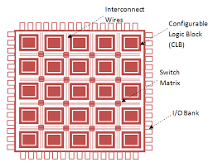
Field Programmable Gate Array (FPGA)
FPGA:
1. Integrated Circuit
2. Programmable or Reprogrammable
It consist of
1. Configurable Logic Block
2. Interconnects Wires
3. I/O
Used reasons:
1. Flexible
2. Faster
3. Parallel processing capabilities
© ENGI-9819(Computer Hardware Found), 2023
www.mun.ca
Notes:
A field-programmable gate array (FPGA) is a type of integrated circuit that can be programmed or reprogrammed after manufacturing.
It consists … that can be configured to perform various digital functions.
FPGAs are commonly used in applications where flexibility, speed, and parallel processing capabilities are required, such as in telecommunications, automotive, aerospace, and industrial sectors.

Slide 5
Benefits of using FPGA in DL/DNN
• Design Benefits:
Can be designed in a more efficient way
Reconfigurable
Power consumption
Flexible
• Benefits Compare to GPU and CPU though they are faster in processing:
Faster in processing
Execute operation in few clock periods
Low Power consumption
Flexible
© ENGI-9819(Computer Hardware Found), 2023
www.mun.ca
Notes:
The utilization of FPGAs in deep learning design offers several notable benefits.
Firstly, FPGAs enable the design of neural networks in a more efficient manner compared to traditional architectures like CPUs and GPUs.
Secondly, FPGAs are inherently reconfigurable. This reconfigurability enhances the versatility of deep learning models and facilitates rapid prototyping.
Thirdly, FPGAs exhibit lower power consumption in comparison to CPUs and GPUs, particularly advantageous in energy-sensitive applications.
The fourth benefit lies in the flexibility of FPGAs, allowing for the implementation of diverse neural network structures.
Despite GPUs and CPUs being known for their faster processing speeds, FPGAs offer distinct advantages that make them a compelling choice for certain applications. FPGAs, not necessarily as fast as GPUs or CPUs in terms of clock frequency,
But they are able to execute operations in a few clock periods. This efficiency allows FPGAs to achieve competitive performance in real-time data processing.

Slide 6
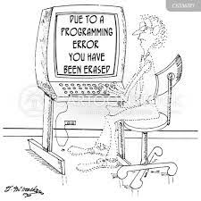
Drawbacks
• Design Benefits:
Reconfigurable Cost
Programming Difficulties
© ENGI-9819(Computer Hardware Found), 2023
www.mun.ca
Notes:
1) Reconfigurable Cost:
2) Programming Difficulty:
While FPGAs offer various benefits in terms of reconfigurability and flexibility, there are also notable drawbacks associated with their usage.
Firstly, the reconfigurable nature of FPGAs introduces a cost factor. The development and manufacturing of reconfigurable hardware can be more expensive compared to fixed architectures like CPUs or GPUs, impacting the overall cost of FPGA-based solutions.
Secondly, programming FPGAs can be challenging. Programming difficulties can arise from the complexity of optimizing and mapping algorithms onto the FPGA architecture. This can potentially create a barrier for software developers less familiar with hardware-level programming, limiting the broader adoption of FPGA technology.
Addressing these drawbacks involves finding ways to mitigate reconfigurable cost challenges and simplifying the programming process to make FPGAs more accessible to a wider range of developers.

Slide 7
FPGA Based Hardware Architectures!!
© INTERNATIONALIZATION OFFICE AND CAREER DEVELOPMENT (STUDENT LIFE), 2023
www.mun.ca

Slide 8
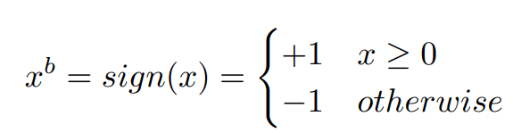
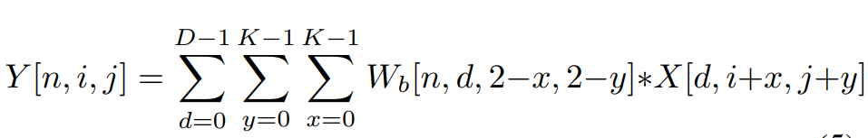
Deep Learning Binary Neural Network on an FPGA
What is the paper about ?
Equations it try to solve
Problem Researcher try to solve
Resource Used
- Hardware : Xilinx FPGA
- Dataset : CIFAR-10
© ENGI-9819(Computer Hardware Found), 2023
www.mun.ca
Notes:
What is the paper about ?
The paper presents the implementation of a binary neural network (BNN) on Xilinx FPGA for real-time object recognition.
Problem Researcher try to solve ?
GPUs are not fit for embedded applications, because they are power hungry. As a result, many researchers investigated ways o implement deep neural networks on low power hardware[9], [10], [12]. This paper modifies binarized neural network to be hardware compatible and implements it on Xilinx FPGA.
Resource Used
- Hardware : Xilinx FPGA
- Dataset : CIFAR-10
Pre-trained weights from training are binarized and Stored in BRAM:
It’s saved significat amount of memory because 8/16 bit data converted into 1 bit. For it memory usage reduced 8/16 times.

Slide 9
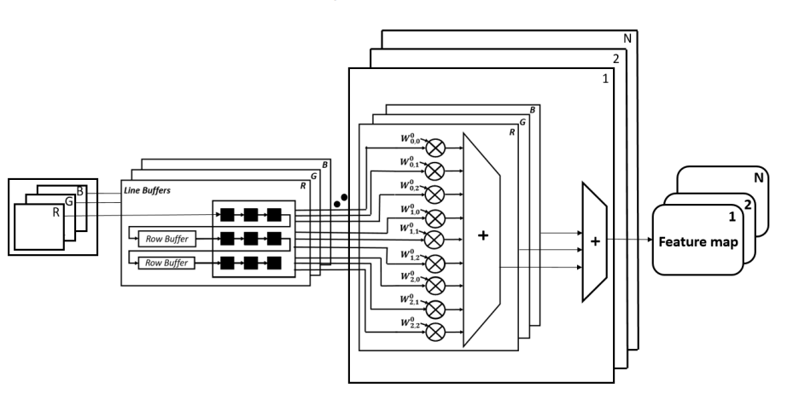
Deep Learning Binary Neural Network on an FPGA
• Pre-trained weights from training are binarized and Stored in BRAM
Figure : First Hidden layer
© ENGI-9819(Computer Hardware Found), 2023
www.mun.ca
Notes:
Architecture realization of the first layer is shown here.
RGB data is provided as input
This figure shows computation of N feature maps when N kernels of size 3 ×3 ×3 interacts with RGB input image. Number of output feature maps are equal to number of kernels

Slide 10
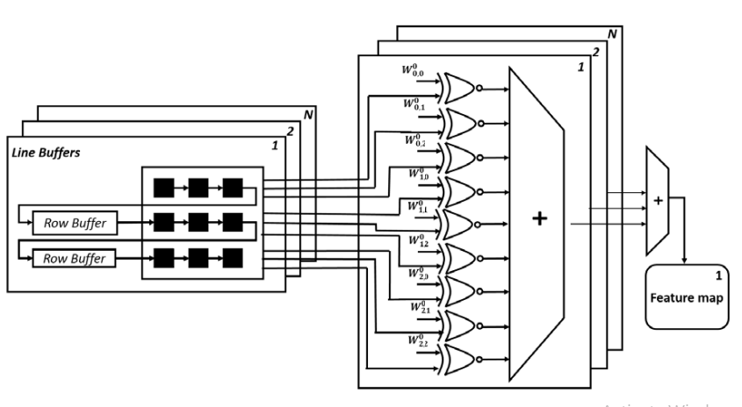
Deep Learning Binary Neural Network on an FPGA
Figure : The 2nd 3rd and 4th convolution layer
• Results
- Accuracy of 86.06% on CIFAR-10 dataset
maximum throughput of 332,158 images per second
-latency 4.9 µsec
© ENGI-9819(Computer Hardware Found), 2023
www.mun.ca
Notes:
This figure shows computation of N output feature maps when input feature maps and N number of 3D kernels are applied to convolutional layer. In this realization, all the multiply operations in the convolutional layer are replaced byXNOR operations. Since 2D convolution operation occupies 90% of computation cost in CNN, replacing most of the multipliers by XNOR gate reduces complexity of computations by a significant amount.
Result
- Accuracy of 86.06% on CIFAR-10 dataset
maximum throughput of 332,158 images per second
-latency 4.9 µsec

Slide 11
Optimization for Efficient Hardware Implementation of CNN on FPGA
What is the paper about ?
Previous Work:
Problem Researcher try to solve
Proposed Solution:
Resource Used
- Hardware : XC6VLX130T-2 FPGA of Xilinx family
Simulator : ModelSim SE 10.5
Xilinx ISE 14.4 is used for synthesis
Vivado 2012.4 is used for implementation.
© ENGI-9819(Computer Hardware Found), 2023
www.mun.ca
Notes:
What is the paper about ?
There is a limitation of resource, power consumption, and area usage on FPGAs. This paper provided a detailed explanation of a proposal to replace Multiply-Accumulate (MAC) units in a Convolutional Neural Network (CNN) accelerator design with a Wallace tree multiplier.
Problem Researcher try to solve ?
->The primary issue is the limited availability of Multiply-Accumulate (MAC) units on FPGAs.
-> Implementing the entire convolution layer in one go is challenging due to the scarcity of MAC units.
Previous Work:
Previous work used loop tiling and implemented a parallel structure with 16 groups of inputs and 16 groups of outputs to overcome resource limitations.
The architecture used 16-bit fixed-point operations with three-stage pipelines for each processing element (PE) unit.
Proposed Solution:
The proposed solution involves replacing the Multiply-Accumulate(MAC) unit with a Wallace tree multiplier.
Wallace tree multiplication is chosen due to its efficiency in reducing partial products and its relatively easy hardware implementation.
The proposed design simplifies further by using simple combinational logic to design full adders (FA) and half adders (HA).

Slide 12
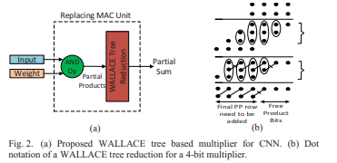
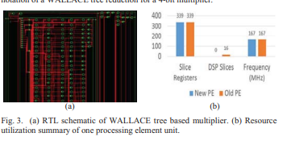
Optimization for Efficient Hardware Implementation of CNN on FPGA
• Results
© ENGI-9819(Computer Hardware Found), 2023
www.mun.ca
Notes:
Multiply-Accumulate(MAC) unit, which is used for multiplication of input feature map and kernel, is replaced with proposed architecture for new Processing Element (PE) as shown in Fig. 2 (a). Simulation is performed using ModelSim SE 10.5 to test the behavior of both the previously implemented Processing Element (PE) and the proposed PE using WALLACE tree based multiplier. The proposed PE design is then synthesized using Xilinx ISE 14.4 and implemented by Vivado 2012.4.
New Processing Element (PE) gives a synthesis frequency of ~167 MHz, utilization of DSP slice is zero, and it uses 339 slice registers. Fig. 3 (a) show0s the RTL schematic of new PE based on WALLACE tree multiplier and it is evident that the implemented design will be facing six full adder delay in its critical path.
Fig. 3 (b) is graphical representation of resource utilization summary of two designs and it can be observed that zero DSP slices are used in proposed PE unit design.

Slide 13
A General Neural Network Hardware Architecture on FPGA
What is the paper about ?
Problem Researcher try to solve
Resource Used
- Hardware : XILINX ZU9CG System On Chip (SOC) platform
© ENGI-9819(Computer Hardware Found), 2023
www.mun.ca
Notes:
What is the paper about ?
This paper try to implement a hardware architecture for deep neural network
Problem Researcher try to solve ?
->

Slide 14
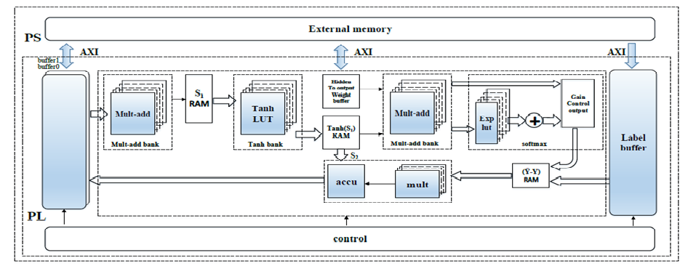
A General Neural Network Hardware Architecture on FPGA
Figure : A General Neural Network Hardware Architecture on FPGA
© ENGI-9819(Computer Hardware Found), 2023
www.mun.ca
Notes:
For the forward process, there are 3 matrix operation stages: input layer to hidden layer, hidden layer to hidden layer, and hidden layer to output layer.
In the first stage, the input vectors X_{i} (i = 1,2,...T) multiply the first hidden layer weights matrix WH1XT which are loaded form the buffer0 and buffer1. We use mult-add bank to accomplish the above matrix operation. The mult-add bank consists of many parallel multiplication and accumulation units, Then the result matrix is stored in the S₁ RAM as the input of activation function. There are lots of activation functions which can be chose in practice such as sigmoid, Rectified Linear Unit (ReLU), Tanh, and so on. The output matrix of the first hidden layer (M1) is stored in the Tanh(S₁) RAM.
In the second stage, the M1 multiplies the second hidden layer weights matrix which still is implemented by mult-add bank. The multi-hidden layers neural network hardware implement can be carried out through the reuse of the mult-add bank, weights RAM, and tanh bank units.
The final stage in the forward process is to perform the matrix mapping from last hidden layer to the output layer.
Result
In the hardware framework, different deep neural networks can be implemented by reusing the forward propagation modules and slightly modifying the backward propagation modules.This will provide a real-time, high energy efficiency, and fast deployment embedded solution for deep learning and machine learning applications.

Slide 15
Application-Specific Integrated Circuit (ASIC)
ASIC:
1. Definition of ASIC
2. Purpose and Optimization
3. Use Cases
4. Features of ASICs
• Customization
• Versatility
5. Comparison with Other Architectures
© ENGI-9819(Computer Hardware Found), 2023
www.mun.ca
Notes:
What is the paper about ?
The paper introduces a FPGA cluster architecture, utilizing the Versatile Tensor Accelerator (VTA), to address challenges in deploying deep learning workloads. It focuses on bridging the gap between hardware and deep learning architecture, emphasizing the advantages of FPGA clusters, and discusses hardware, firmware, and software aspects, presenting results demonstrating improved performance with the proposed system.
Problem Researcher try to solve ?
The researchers aim to address the challenges in deploying deep learning (DL) workloads by proposing an FPGA cluster architecture for efficient and adaptable hardware acceleration. They specifically tackle the gap between DL frameworks and traditional hardware designs, emphasizing the limitations of Electronic Design Automation (EDA) tools and the time-consuming nature of developing dedicated Application Specific Integrated Circuit (ASIC) hardware for DL. The proposed solution leverages FPGA clusters interconnected through an Ethernet switch and introduces the Versatile Tensor Accelerator (VTA) as an open-source deep learning accelerator. The problem centers around optimizing hardware-software co-designs for DL, particularly in edge computing applications, where low latency and high performance are crucial.
Proposed Solution:
The proposed solution involves replacing the Multiply-Accumulate(MAC) unit with a Wallace tree multiplier.
Wallace tree multiplication is chosen due to its efficiency in reducing partial products and its relatively easy hardware implementation.
The proposed design simplifies further by using simple combinational logic to design full adders (FA) and half adders (HA).
what is the proposed solution?
The proposed solution involves utilizing FPGA (Field-Programmable Gate Array) clusters as a hardware stack for implementing deep learning accelerators. The FPGA cluster architecture is designed to address the challenges in supporting new operations and handling varying workloads in edge computing applications. The architecture features two types of FPGA SoCs: a compute-lite cluster with up to 12 Xilinx Zynq-7020 chips and a more computationally intensive cluster with 5 Zynq UltraScale+ MPSoC platforms. These FPGAs are interconnected through an Ethernet switch.
To enhance the deep learning acceleration, the paper introduces the Versatile Tensor Accelerator (VTA), an open-source, scalable, and customizable deep learning accelerator. VTA is designed to work seamlessly with popular deep learning frameworks like Apache TVM, providing a flexible and extensible infrastructure that supports various neural network models. The modular architecture of VTA allows for customizable and optimizable hardware parameters to suit specific application requirements. The paper also discusses the software components running on a PC to control processes on the FPGAs.
In summary, the proposed solution involves a combination of FPGA cluster architecture and the Versatile Tensor Accelerator to create efficient and adaptable deep learning systems, particularly suitable for edge computing applications.

Slide 16
Benefits of using ASIC:
4. System Complexity Reduction
Integration of Functions
Streamlined Design
5. Economic Viability
Potential Cost Offset
Long-Term Viability
Remarkable Performance
Precision Design
Tailored Circuitry
2. Power Efficiency
3. Customization Capabilities
Precision Customization
Dual Improvement
© ENGI-9819(Computer Hardware Found), 2023
www.mun.ca
Notes:
What is the paper about ?
The paper introduces a FPGA cluster architecture, utilizing the Versatile Tensor Accelerator (VTA), to address challenges in deploying deep learning workloads. It focuses on bridging the gap between hardware and deep learning architecture, emphasizing the advantages of FPGA clusters, and discusses hardware, firmware, and software aspects, presenting results demonstrating improved performance with the proposed system.
Problem Researcher try to solve ?
The researchers aim to address the challenges in deploying deep learning (DL) workloads by proposing an FPGA cluster architecture for efficient and adaptable hardware acceleration. They specifically tackle the gap between DL frameworks and traditional hardware designs, emphasizing the limitations of Electronic Design Automation (EDA) tools and the time-consuming nature of developing dedicated Application Specific Integrated Circuit (ASIC) hardware for DL. The proposed solution leverages FPGA clusters interconnected through an Ethernet switch and introduces the Versatile Tensor Accelerator (VTA) as an open-source deep learning accelerator. The problem centers around optimizing hardware-software co-designs for DL, particularly in edge computing applications, where low latency and high performance are crucial.
Proposed Solution:
The proposed solution involves replacing the Multiply-Accumulate(MAC) unit with a Wallace tree multiplier.
Wallace tree multiplication is chosen due to its efficiency in reducing partial products and its relatively easy hardware implementation.
The proposed design simplifies further by using simple combinational logic to design full adders (FA) and half adders (HA).
what is the proposed solution?
The proposed solution involves utilizing FPGA (Field-Programmable Gate Array) clusters as a hardware stack for implementing deep learning accelerators. The FPGA cluster architecture is designed to address the challenges in supporting new operations and handling varying workloads in edge computing applications. The architecture features two types of FPGA SoCs: a compute-lite cluster with up to 12 Xilinx Zynq-7020 chips and a more computationally intensive cluster with 5 Zynq UltraScale+ MPSoC platforms. These FPGAs are interconnected through an Ethernet switch.
To enhance the deep learning acceleration, the paper introduces the Versatile Tensor Accelerator (VTA), an open-source, scalable, and customizable deep learning accelerator. VTA is designed to work seamlessly with popular deep learning frameworks like Apache TVM, providing a flexible and extensible infrastructure that supports various neural network models. The modular architecture of VTA allows for customizable and optimizable hardware parameters to suit specific application requirements. The paper also discusses the software components running on a PC to control processes on the FPGAs.
In summary, the proposed solution involves a combination of FPGA cluster architecture and the Versatile Tensor Accelerator to create efficient and adaptable deep learning systems, particularly suitable for edge computing applications.

Slide 17
Drawbacks of using ASIC
1. Substantial Initial Development Expense
Financial Feasibility
Complexity
2. Long Development Cycle
Time-Consuming
Potential Delays
3. Lack of Flexibility
Not as Adaptable
Difficulty in Modifications
4. Risk of Obsolescence
Technology Dependency
Redesign Costs
5. Economic Viability
Resource Intensive
Consideration Needed
© ENGI-9819(Computer Hardware Found), 2023
www.mun.ca
Notes:
What is the paper about ?
The paper introduces a FPGA cluster architecture, utilizing the Versatile Tensor Accelerator (VTA), to address challenges in deploying deep learning workloads. It focuses on bridging the gap between hardware and deep learning architecture, emphasizing the advantages of FPGA clusters, and discusses hardware, firmware, and software aspects, presenting results demonstrating improved performance with the proposed system.
Problem Researcher try to solve ?
The researchers aim to address the challenges in deploying deep learning (DL) workloads by proposing an FPGA cluster architecture for efficient and adaptable hardware acceleration. They specifically tackle the gap between DL frameworks and traditional hardware designs, emphasizing the limitations of Electronic Design Automation (EDA) tools and the time-consuming nature of developing dedicated Application Specific Integrated Circuit (ASIC) hardware for DL. The proposed solution leverages FPGA clusters interconnected through an Ethernet switch and introduces the Versatile Tensor Accelerator (VTA) as an open-source deep learning accelerator. The problem centers around optimizing hardware-software co-designs for DL, particularly in edge computing applications, where low latency and high performance are crucial.
Proposed Solution:
The proposed solution involves replacing the Multiply-Accumulate(MAC) unit with a Wallace tree multiplier.
Wallace tree multiplication is chosen due to its efficiency in reducing partial products and its relatively easy hardware implementation.
The proposed design simplifies further by using simple combinational logic to design full adders (FA) and half adders (HA).
what is the proposed solution?
The proposed solution involves utilizing FPGA (Field-Programmable Gate Array) clusters as a hardware stack for implementing deep learning accelerators. The FPGA cluster architecture is designed to address the challenges in supporting new operations and handling varying workloads in edge computing applications. The architecture features two types of FPGA SoCs: a compute-lite cluster with up to 12 Xilinx Zynq-7020 chips and a more computationally intensive cluster with 5 Zynq UltraScale+ MPSoC platforms. These FPGAs are interconnected through an Ethernet switch.
To enhance the deep learning acceleration, the paper introduces the Versatile Tensor Accelerator (VTA), an open-source, scalable, and customizable deep learning accelerator. VTA is designed to work seamlessly with popular deep learning frameworks like Apache TVM, providing a flexible and extensible infrastructure that supports various neural network models. The modular architecture of VTA allows for customizable and optimizable hardware parameters to suit specific application requirements. The paper also discusses the software components running on a PC to control processes on the FPGAs.
In summary, the proposed solution involves a combination of FPGA cluster architecture and the Versatile Tensor Accelerator to create efficient and adaptable deep learning systems, particularly suitable for edge computing applications.

Slide 18
Hardware Architectures!!
© INTERNATIONALIZATION OFFICE AND CAREER DEVELOPMENT (STUDENT LIFE), 2023
www.mun.ca

Slide 19
You Cannot Improve What You Do not Measure: FPGA vs. ASIC Efficiency Gaps for Convolutional Neural Network Inference
What is the paper about ?
Problem Researcher try to solve
Resource Used
- Implementation of three CNN architectures on FPGAs and ASICs.
- Analyzing efficiency differences in area and performance.
- Quantitative results presentation for both platforms.
- Exploration of potential architectural changes for FPGA efficiency.
© ENGI-9819(Computer Hardware Found), 2023
www.mun.ca
Notes:
What is the paper about?
FPGA vs. ASIC in deep learning: performance and area costs.
Quantitative comparison of three CNN architectures on both platforms.
Potential FPGA architectural modifications for efficiency.
Problem:
Focus on FPGA vs. ASIC efficiency in CNN inference.
Quantitative field and results comparison.
Discussion of FPGA advantages and drawbacks in deep learning.

Slide 20
You Cannot Improve What You Do not Measure: FPGA vs. ASIC Efficiency Gaps for Convolutional Neural Network Inference
Methodology
Implementing fully-connected, convolutional, and residual neural networks.
Comparison through analytical performance models and RTL simulations.
Studying efficiency differences in area and performance on FPGA and ASIC platforms.
© ENGI-9819(Computer Hardware Found), 2023
www.mun.ca
Notes:
Pre-trained weights from training are binarized and Stored in BRAM:
It’s saved significat amount of memory because 8/16 bit data converted into 1 bit. For it memory usage reduced 8/16 times.

Slide 21
You Cannot Improve What You Do not Measure: FPGA vs. ASIC Efficiency Gaps for Convolutional Neural Network Inference
Result:
ASICs outperform FPGAs: 2.5x for fully-connected, 3.5x for convolutional, 4.5x for residual neural network.
Exploration of FPGA architectural changes leading to a proposed hybrid approach.
Proposed architecture achieves 2.5x vs. fully-connected on FPGAs, 1.5x vs. ASICs.
Significant improvement over traditional FPGA architectures.
© ENGI-9819(Computer Hardware Found), 2023
www.mun.ca
Notes:
Pre-trained weights from training are binarized and Stored in BRAM:
It’s saved significat amount of memory because 8/16 bit data converted into 1 bit. For it memory usage reduced 8/16 times.

Slide 22
DeepOpt: Optimized Scheduling of CNN Workloads for ASIC-based Systolic Deep Learning Accelerators
What is the paper about ?
Problem Researcher try to solve
Resource Used
- Solution: DeepOpt - ASIC-based systolic hardware accelerators.
- Approach: Layer-specific and hardware-specific scheduling strategy.
- Objective: Maximize hardware resource utilization, minimize memory transactions
© ENGI-9819(Computer Hardware Found), 2023
www.mun.ca
Notes:
What is the paper about?
Challenge: High energy consumption and latency in deep learning computations.
Solution: DeepOpt - an optimization framework for ASIC-based systolic hardware accelerators.
Goal: Optimize energy and latency through layer-specific and hardware-specific scheduling.
Problem:
Problem: Scheduling computations in each layer of a CNN on a DL accelerator.
Difficulty: Numerous parameters, limited hardware resources, and variable factors.
Impact: Decisions affect energy and throughput due to memory transaction bottlenecks.

Slide 23
You Cannot Improve What You Do not Measure: FPGA vs. ASIC Efficiency Gaps for Convolutional Neural Network Inference
Methodology
Components: Layer-specific scheduling, hardware-specific scheduling, design space exploration.
Evaluation: ASIC-based systolic hardware accelerator.
Testing: Multiple CNNs, varied hardware configurations, and architectures.
© ENGI-9819(Computer Hardware Found), 2023
www.mun.ca
Notes:
Pre-trained weights from training are binarized and Stored in BRAM:
It’s saved significat amount of memory because 8/16 bit data converted into 1 bit. For it memory usage reduced 8/16 times.

Slide 24
You Cannot Improve What You Do not Measure: FPGA vs. ASIC Efficiency Gaps for Convolutional Neural Network Inference
Evaluation:
ASICs outperform FPGAs: 2.5x for fully-connected, 3.5x for convolutional, 4.5x for residual neural network.
Exploration of FPGA architectural changes leading to a proposed hybrid approach.
Proposed architecture achieves 2.5x vs. fully-connected on FPGAs, 1.5x vs. ASICs.
Significant improvement over traditional FPGA architectures.
Results:
Significant Achievements: Up to 2.5x energy savings and up to 1.8x throughput improvement with DeepOpt.
Versatility: DeepOpt performs well with various CNN architectures and hardware configurations.
© ENGI-9819(Computer Hardware Found), 2023
www.mun.ca
Notes:
Pre-trained weights from training are binarized and Stored in BRAM:
It’s saved significat amount of memory because 8/16 bit data converted into 1 bit. For it memory usage reduced 8/16 times.

